Slide 1

E-Commerce Product
Recommendation System
Arya Patil 22107047
Nisha Patel 22107037
Prachi Pawar 22107018
Renuka Udugade 22107048
Project Guide
Ms. Poonam Pangarkar
Notes:
1

Slide 2
Outline
Introduction
Literature Survey of the existing systems
Limitations of the existing systems
Problem statement
System Design
Technologies and methodologies
Implementation
Conclusion
References
Notes:
2

Slide 3
Introduction
Machine learning-based project that provides personalized product recommendations to users based on their search.
Utilizes algorithms to analyze user behavior and generate relevant recommendations.
To improve the overall shopping experience for users, increase sales for e-commerce businesses.
Motivation
Personalized recommendations can significantly improve the shopping experience and increase customer loyalty.
Effective recommendation systems can lead to higher conversion rates, increased sales, and reduced customer churn.
Notes:
3

Slide 4
Objectives
To imply Collaborative Filtering by utilizing Matrix Factorization to discover hidden user interests and product characteristics.
To create a personalized product recommendation system using Content-based Filtering and cosine similarity.
To use a Hybrid Approach to provide more accurate and diverse recommendations.
To use user ratings data to provide trending product suggestions, thereby increasing customer engagement, and driving sales.
Notes:
4

Slide 5
Literature Survey of the existing system
Sr. No | Title | Author | Year | Outcomes | Methodology | Demerits
1 | [1] Development of Recommendation System in e-Commerce using Emotional Analysis and Machine Learning Methods | T. Mykhalchuk T. Zatonatska L. Liakhovych | 2021 | To increase the functionality and efficiency of e- business. | Data preprocessing and analysis | Not an expert system Our approach: Developing an expert system solved Python programming languages, data processing and Analysis.
Notes:
5

Slide 6
Literature Survey of the existing system
Sr. No | Title | Author | Year | Outcomes | Methodology | Demerits
2 | [2] Recommendation system in E-commerce websites: A Graph Based Approached | Ms. Shakila Shaikh Dr. Sheetal Rathi Asst Prof. Prachi Janrao | 2017 | Use of graph algorithms, which could enhance recommendation systems | Content-based systems Collaborative filtering systems Hybrid systems | Not every user interacts with every product, leading to incomplete graphs that may affect the performance of recommendation systems. Our approach: Using Matrix factorization to overcome the above problem
Notes:
6

Slide 7
Literature Survey of the existing system
Sr. No | Title | Author | Year | Outcomes | Methodology | Demerits
3 | [3] Solutions for Problems of Existing E-Commerce Recommendation System | Gao Zhipeng Li Zhixing Niu Kun | 2016 | Recommendation system includes user model, the recommended model and recommendation algorithm. | Content-based systems Collaborative filtering systems Hybrid systems | Cold start problem Our approach: Using Rating algorithm to overcome the cold start problem
Notes:
7

Slide 8
Limitations of the existing system
While e-commerce recommendation systems offer significant benefits, they also have certain limitations:
When a new user joins, there’s no historical data on their preferences, making personalized recommendations difficult.
Recommendation systems tend to promote popular items, often ignoring less popular products.
User preferences change over time, but many recommendation algorithms assume static preferences.
Notes:
8

Slide 9
Problem statement
In recommendation systems, cold start problem arises when the system lacks sufficient data to make accurate recommendations for new users, new items, or in the early stages of system deployment.
Recommendation When a new user joins the platform, the system has no historical data about their preferences, making it difficult to generate personalized recommendations.
This problem can be solved by using Rating Based Algorithm.
Notes:
9

Slide 10
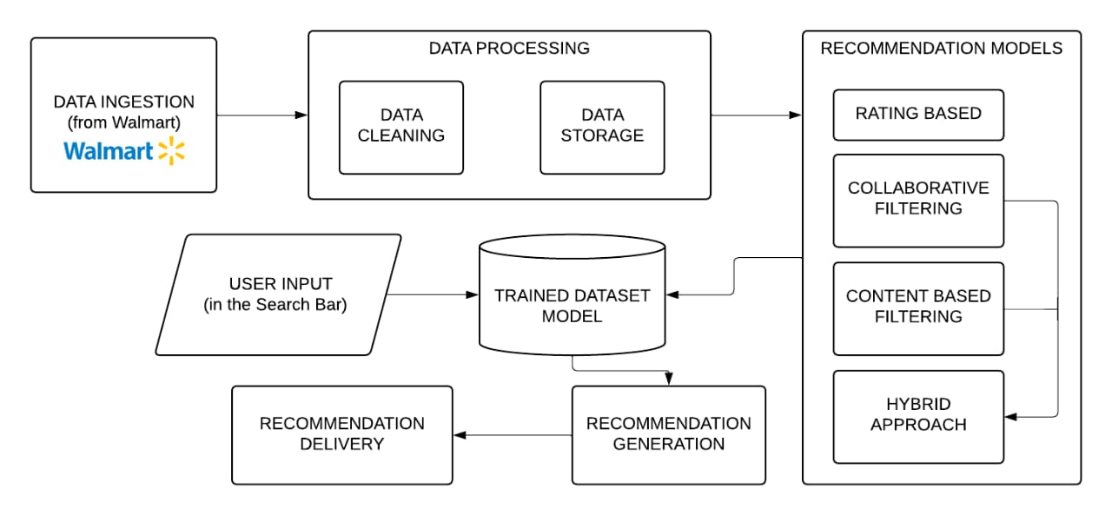
System Design
Notes:
10

Slide 11
Technologies and methodologies
Dataset
Source: Walmart
Size: 5000x30
Front-end
HTML
CSS
Back-end
Python
Platform
Jupyter Notebook 7.0.8
Pycharm 24.2.3
XAMPP Control Panel v3.3.0
Notes:
11

Slide 12

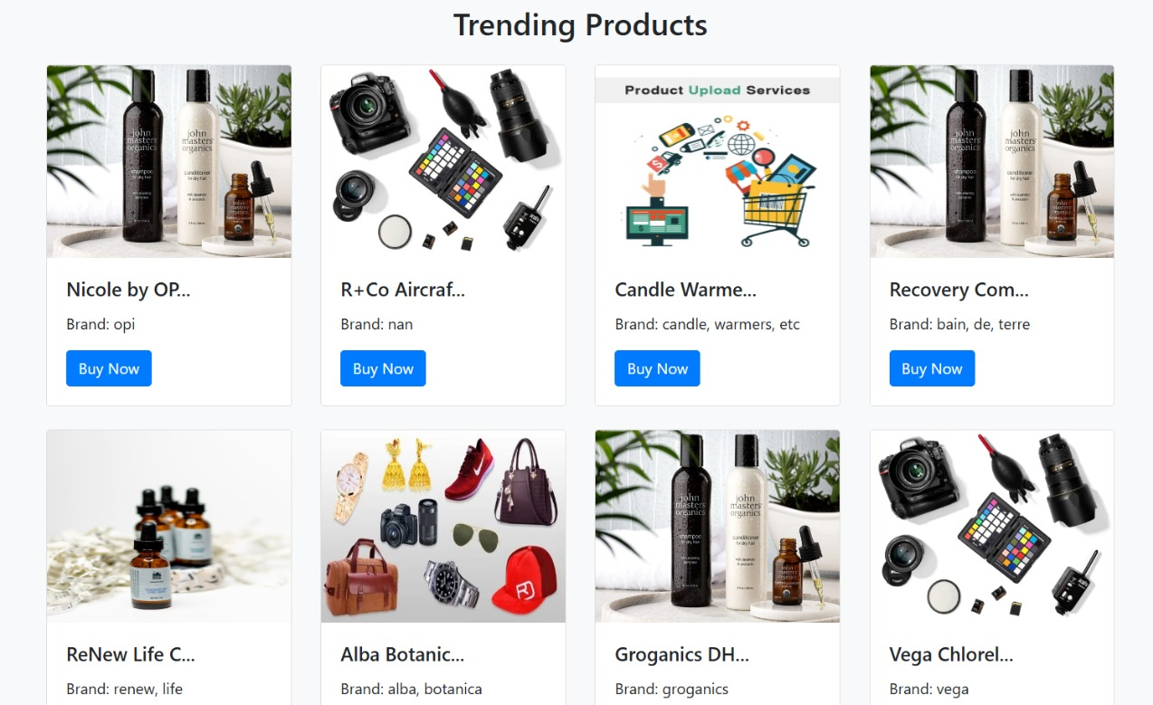
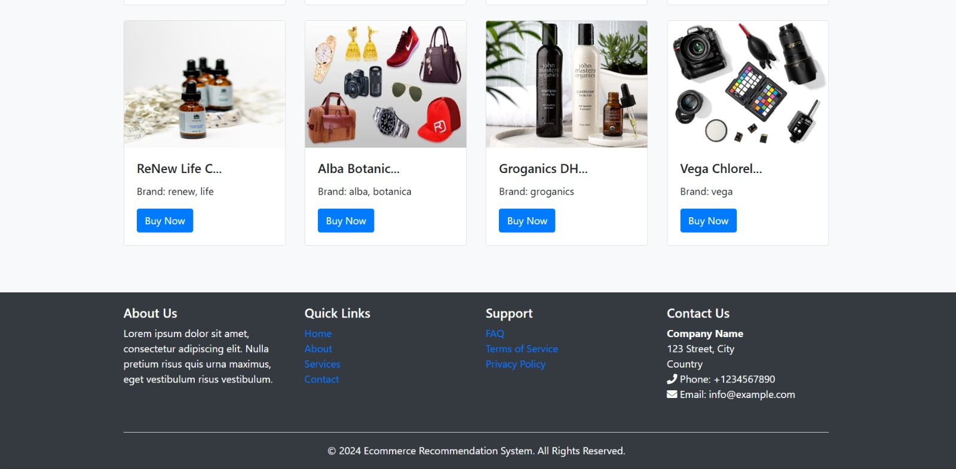
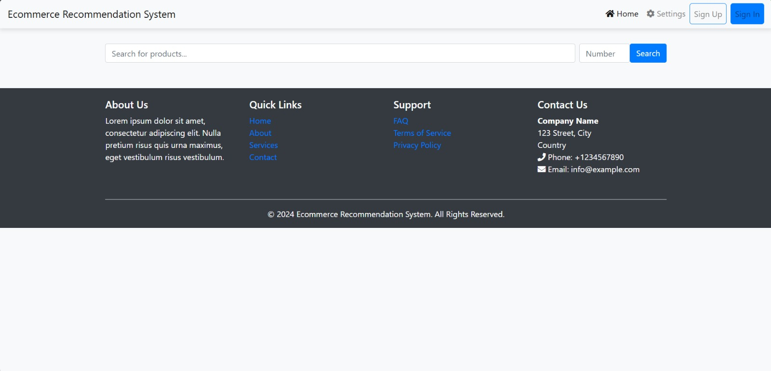
Implementation
Notes:
12

Slide 13
Conclusion
E-commerce recommendation systems are a powerful tool for improving customer experience and driving business success.
By leveraging data-driven algorithms, these systems provide personalized, relevant product suggestions that help users discover new items, increase engagement, and improve conversion rates.
In conclusion, the development and continuous optimization of e-commerce recommendation systems are essential for businesses looking to provide personalized shopping experiences, improve customer satisfaction, and boost sales in an increasingly competitive market.
Notes:
13

Slide 14
References
[1] T. Mykhalchuk, T. Zatonatska and L. Liakhovych (2021) , "Development of Recommendation System in e-Commerce using Emotional Analysis and Machine Learning Methods”, 11th IEEE International Conference on Intelligent Data Acquisition and Advanced Computing Systems: Technology and Applications (IDAACS)
[2] Shaikh Shakila, Rathi Sheetal, Janrao Prachi (2017), “Recommendation System in E-Commerce Websites: A Graph Based Approached”, IEEE 7th International Advance Computing Conference (IACC)
[3] Gao Zhipeng, Li Zhixing, Niu Kun (2016) , “Solutions for problems of existing E-Commerce recommendation system”, IEEE International Conference on Consumer Electronics-Taiwan (ICCE-TW) - Nantou County, Taiwan.
Notes:
14

Slide 15
Thank You...!!
Notes:
15

